Slide 1
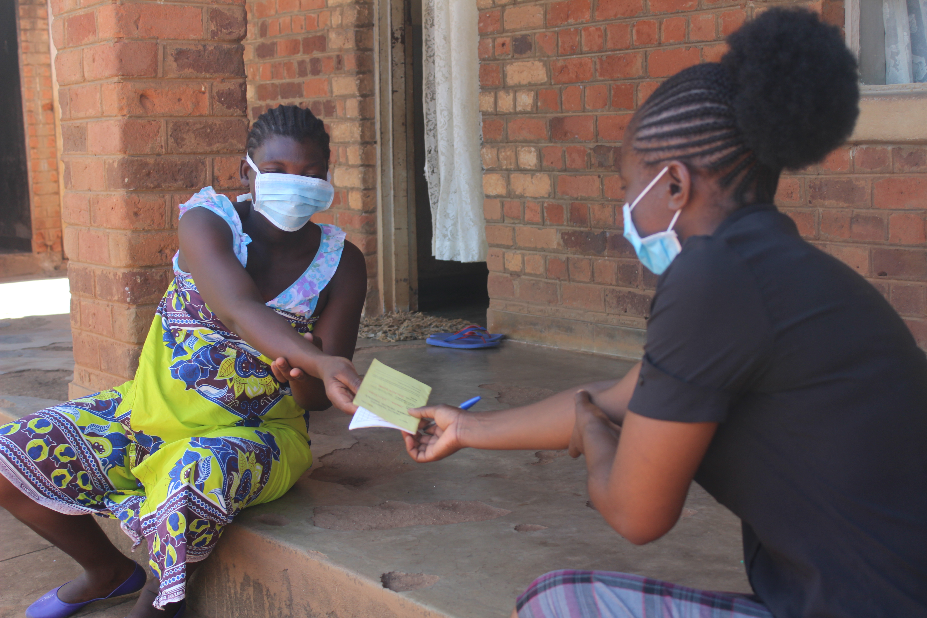
Delivery of intermittent preventive treatment of Malaria in pregnancy at the community level to reduce the access barriers of care: Results of a cluster randomized trial in Malawi
Abstract #IMNHC338
by: Sarah Birse,¹ Rudolph Thetard,¹ Tamar Chitasvili,¹ John Munthali,¹ Ethel Chilima,¹ Jobiba Chinkhumba,² Tyson Volkman,³ Monica Bautista³
affiliation:¹Management Sciences for Health; ²University of Malawi College of Medicine; ³US President’s Malaria Initiative
Background
Malaria in pregnancy (MIP) is associated with poor maternal and perinatal health outcomes.
No sub-Saharan African country has achieved the 85% coverage target for three doses of intermittent preventive treatment (IPTp) with sulfadoxine-pyrimethamine (SP) set by WHO.
In 2017, only 41.1% of Malawian women who recently gave birth received IPTp3+.
Study Design
We explored the feasibility of community-based delivery of IPTp-SP (cIPTp) via health surveillance assistants (HSAs) to complement facility-based provision.
A cluster randomized control trial was conducted across 2 districts (Nkhatabay and Ntcheu) with a 21-month period of implementation.
The study is designed to test whether engaging HSAs in cIPTp would increase coverage of 3+ doses compared to delivery only at ANC clinics, while at the same time improving or maintaining ANC attendance.
ANC4+ coverage increased significantly in intervention group
Overall increases to IPTp3+ coverage in both groups
Other Noteworthy Results
Distance from facilities: 67.7% (N = 42/62) of women living more than 5 km from the health facility received IPTp3 compared with 48.7% (N = 55/113) in the control arm.
Increase in knowledge of MIP interventions: More women recognized IPTp as a malaria prevention intervention in the intervention areas than in the control areas.
Conclusions
Complementary community-based and facility-based services can improve coverage of service delivery.
HSAs can provide cIPTp without negatively impacting routine and timely ANC visits.
Factors, such as the distance to facility, apparently impacted results; there is a need to understand the parameters for cIPTp deployment.
Scan the code to the right to view our IMNHC event page.
Citation: Rubenstein, B.L., Chinkhumba, J., Chilima, E. et al. A cluster randomized trial of delivery of intermittent preventive treatment of malaria in pregnancy at the community level in Malawi. Malar J 21, 195 (2022). https://doi.org/10.1186/s12936-022-04216-4
Methods
Representative samples of women who delivered in the prior 12 months were surveyed at baseline (n = 370, December 2017) and endline (n = 687, August 2020).
At control sites, IPTp was delivered at health facilities during routine ANC.
A difference in differences (Diff-in-diff) analysis was conducted to assess the change in coverage of IPTp and ANC over time, accounting for clustering at the health facility level.
Acknowledgment: This study was funded by the US President's Malaria Initiative through the MSH-led USAID ONSE Health Activity. It was conducted between 2017 and 2020 in collaboration with the Malawi's Ministry of Health.
Notes:
IPTp3+ coverage increased in both intervention and control groups.
ANC4 + coverage increased significantly in the intervention group.
Images
If you are adding images of charts, pictures, or other graphics, you will need high-resolution versions of those images. We recommend re-creating tables and charts inside of PowerPoint or Excel and then placing them into PowerPoint, so they are high resolution, rather than using screenshots / jpegs. If you use images, graphics, etc. that are low resolution, they will be pixelated and blurry.

