Slide 1

Improving maternal and newborn commodity management through the SPARS approach in Madagascar
Serge Ramahazomanana
MNCH advisor - Management Sciences for Health
a partner on the USAID/IMPACT Project, implemented by PSI Madagascar
Abstract # 1345

Slide 2


Background (1)
Madagascar’s health commodity supply chain faces several challenges that lead
to stock-outs and poor quality of health care services.
Challenges include inability of staff of district warehouses
(Pha-G-Dis) to:
Accurately estimate the commodities they need
Report stock status data in a comprehensive and timely manner
Adhere to Central Medical Store’s cyclical order schedule
Coordinate commodity dispatches
to health facilities served by the warehouse

Slide 3


Background (2)
  In addition, regular supervision and evaluation are lacking because of the limited capacity of the Ministry of Public Health (MOPH).
  To address supply chain challenges and improve pharmaceutical management,
  the USAID-funded Improving Market Partnerships and Access to Commodities Together (IMPACT) project adapted MSH’s Supervision, Performance Assessment, and Recognition Strategy (SPARS) to the Madagascar context in 2020.
  Since 2020, Madagascar has implemented the SPARS approach in 78 districts supported by USAID with the support of MSH through the IMPACT project
  (out of 114 districts nationwide).

Slide 4

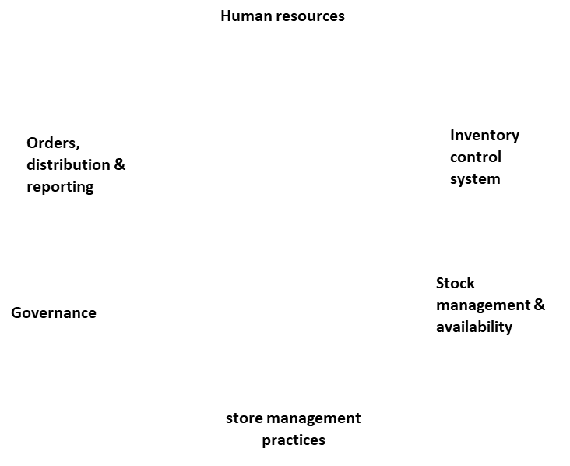
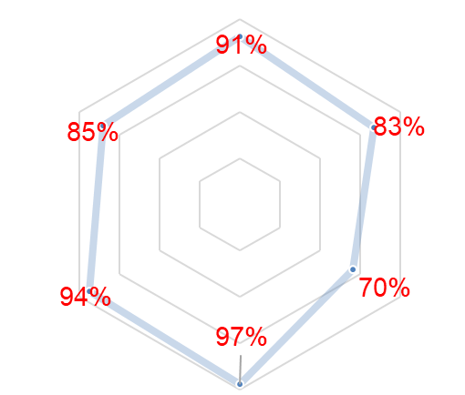
Methods (1)
SPARS is an indicator-based, multi-pronged intervention strategy that combines:
Supervision
On-the-job training
Provision of tools and guidelines
Structured performance reviews
To identify and prioritize issues and encourage progress by rewarding improvements
Example of results of SPARS assessment
in the different domains

Slide 5
Methods (2)
A specific evaluation tool is used
for all visits (adapted from Uganda approach, consolidated with the MOPH's existing tool, tested, and finalized from March to July 2020).
SPARS visits are carried out by trained regional or district health management teams with technical and logistical support from
IMPACT staff.
78 (focus districts of the project) out of 115 district warehouses in Madagascar were visited roughly once a quarter
The scoring grid is reviewed with the warehouse staff and District PSM Committee.
Objective: 90% or higher of the composite score or improvement of SPARS scores by at least five points.

Slide 6
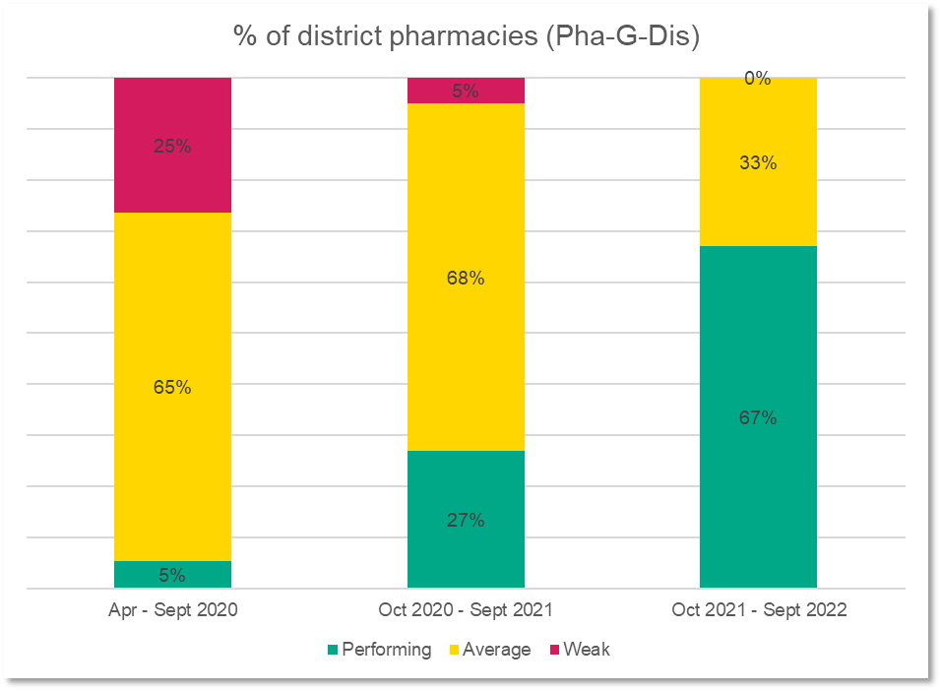
Results (1)
Improved SPARS scores among the 78 Pha-G-Dis
All 78 IMPACT-supported Pha-G-Dis received:
A SPARS baseline assessment in
April-September 2020
At least one follow-up assessment between October 2020 and September 2021
At least one second follow-up assessment between October 2021 and June 2022
% district pharmacies (Pha-G-Dis)

Slide 7
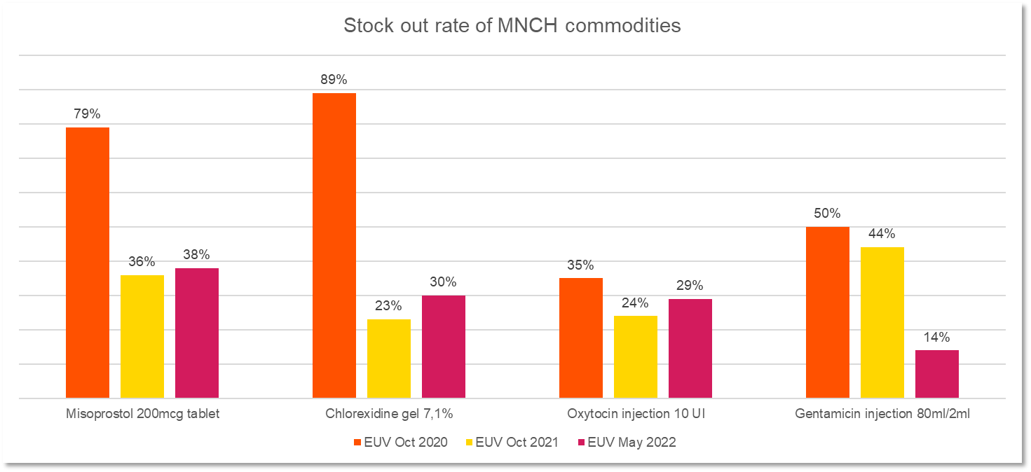
Results (2)
Decreased stock-out rates for MNCH commodities
Stock-out rate of MNCH commodities
Misoprostol 200mcg tablet
Chlorhexidine gel 7,1%
Oxytocin injection 10 UI
Gentamicin injection 80ml/2ml
Source: End Use Verification (EUV) Survey

Slide 8




Conclusion (1)
SPARS is a useful way to measure Pha-G-Dis performance, track progress over time, and plan actions to improve performance.
SPARS data can also be used in higher-level planning and coordination.
SPARS has improved district-level supply chain management of essential MNCH commodities.
Photo credit: Samy Rakotoniaina/MSH/

Slide 9

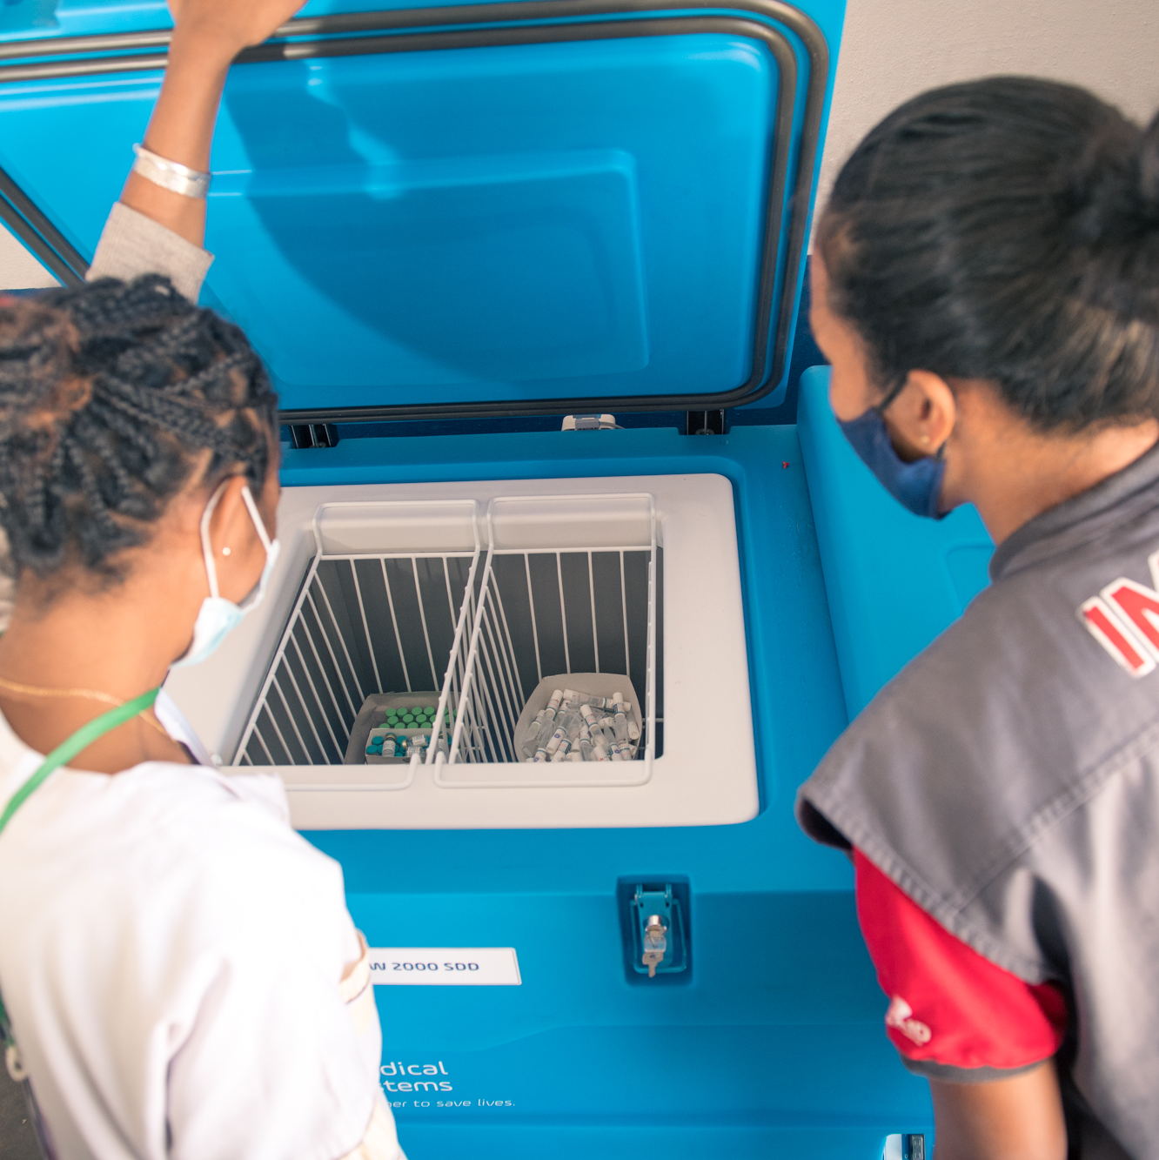
Conclusion (2)
IMPACT is supporting scale up of SPARS approach nationwide.
Initially, through documenting the approach
and systematizing the indicator database
so each district can see their own results
Supported MOPH in revising stock management manual and integrated the SPARS approach
Next, support MOPH in orienting other districts on the approach
Photo credit: Samy Rakotoniaina/MSH/

Slide 10
Recommendations for the field
Scale up the SPARS approach in other areas
Make adaptations as needed to the approach, e.g.,
  Tailored the frequency of SPARS visits based on Pha-G-Dis performance in previous assessments.
Increased the cut-off for the performing category from 80% to 90% to encourage districts to attain their best levels of performance.
  Implemented SPARS through existing supervisory mechanism in Madagascar.
Include a material needs assessment early in SPARS implementation and engage stakeholders to supply pharmacies with necessary equipment
Document evidence for the SPARS approach

Slide 11

Thank you!
This presentation is made possible by the generous support of the American people through the United States Agency for International Development (USAID). The contents are the responsibility of the USAID Improving Market Partnerships and Access to Commodities Together (IMPACT) project and do not necessarily reflect the views of USAID or the United States Government.

